Slide 1
HM001(056-11576-06) P2 MSOP
Made by：Mengbing Sun
Check by：Qinqin Li
Made time：2020-11-18
Check time：2020-11-24
Revision： 03

Slide 2
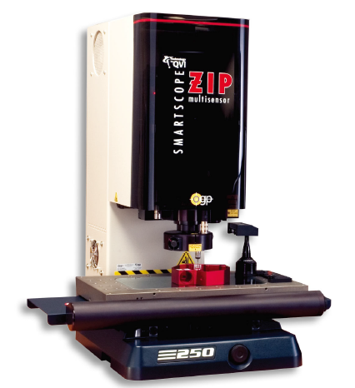
HM001 056-11576-06 MSOP |测量设备-1#
Device name | OMM
Manufacturer | OGP
Device type | ZIP 250
Measuring Range | 250(X)×150(Y)×200(Z) mm
CCD Measuring Accuracy | X,Y: (1.8+6L/1000)μm Z: (2.5+5L/1000)μm (L: measure distance/mm)
Digital counter resolution | 0.001mm
Moving method | Automatic moving

Slide 3
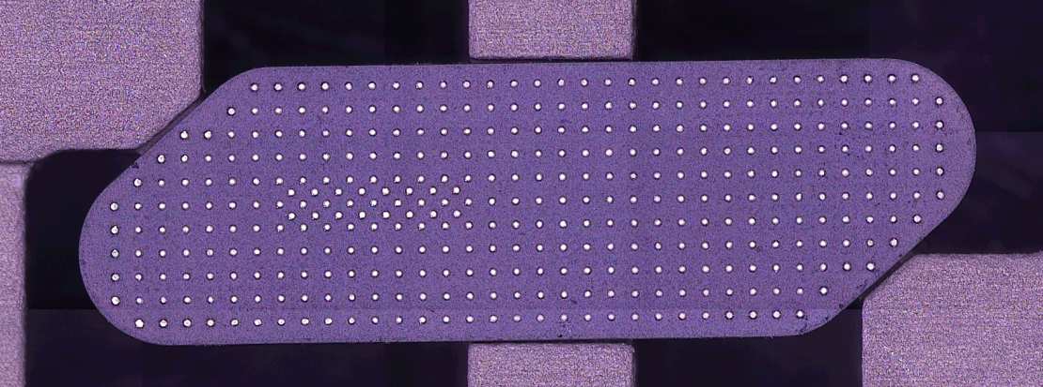
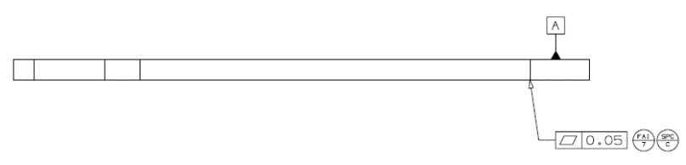
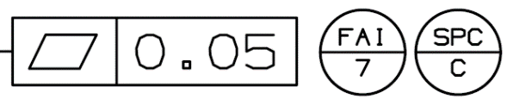
HM001 056-11576-06 | MSOP
FAI/ SPC | -FAI 7 SPC C | Fixture | -N/A
Geometric Feature | -Flatness | Measurement Procedure | -Step 1 根据坐标值测量点P1-P20 -Step 2 拟合P1-P20(避开锡球位置)为平面PL1，计算平面度为FAI 7 =MAX(P1:P20)+ABS(MIN(P1:P20)) ,取点位置如图所示。 -Step 1 Measure points P1-P20 according to the coordinate values -Step 2 Fit P1-P20 (avoid solder ball position) as plane PL1, calculate flatness as FAI 7 = MAX (P1: P20) + ABS (min (P1: P20)), take the point position as shown in the figure.
Datums | -Datum1
Measurement Method | -Equipment :OMM -Multiplying power: 208X -Light source: 40%-60%
PL1 flatness =FAI 7 SPC C
Y
PL1
P16
P17
P18
P19
P20
P11
P12
P13
P14
P15
P6
P7
P8
P9
P10
P1
P2
P3
P4
P5
X
 | P1 | P2 | P3 | P4 | P5 | P6 | P7 | P8 | P9 | P10
X | 1.65 | 5.05 | 9.04 | 12.43 | 16.39 | 1.65 | 5.05 | 9.04 | 12.43 | 16.39
Y | 0.77 | 0.77 | 0.77 | 0.77 | 0.77 | 2.46 | 2.46 | 2.46 | 2.46 | 2.46
 | P11 | P12 | P13 | P14 | P15 | P16 | P17 | P18 | P19 | P20
X | 5.05 | 9.04 | 12.43 | 16.39 | 19.81 | 5.05 | 9.04 | 12.43 | 16.39 | 19.81
Y | 4.15 | 4.15 | 4.15 | 4.15 | 4.15 | 5.86 | 5.86 | 5.86 | 5.86 | 5.86

